Slide 1

Formal Models in OOP
Presented by:
Elizer Ponio Jr.

Slide 2
Outline
Unified Modeling Language
UML Class Diagram
Formal Specification Languages

Slide 3


Unified Modeling Language
Unified Modeling Language (UML) is a general purpose modelling language that is used to visualize the way a system has been designed.
It is similar to blueprints used in other fields of engineering.
UML is not a programming language, it is a visual language.

Slide 4

Do we really need UML?
Complex applications need collaboration and planning from multiple teams and hence require a clear and concise way to communicate amongst them.
Businessmen do not understand code. UML becomes essential to communicate with non-programmers the essential requirements, functionalities and processes of the system.

Slide 5

Do we really need UML?
A lot of time is saved down the line when teams can visualize processes, user interactions and static structure of the system.
UML is linked with object-oriented design and analysis. UML makes the use of elements and forms associations between them to form diagrams.

Slide 6
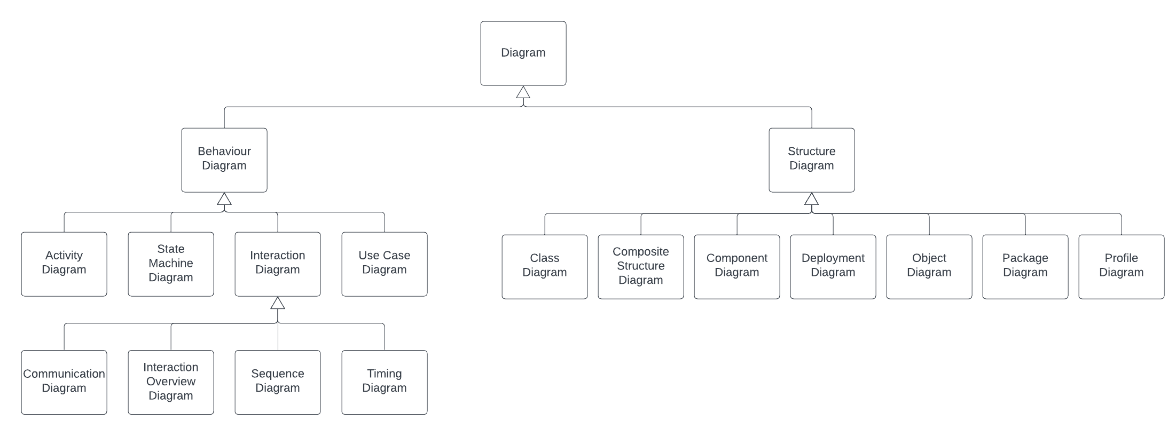

Slide 7
Outline
Unified Modeling Language
UML Class Diagram
Formal Specification Languages

Slide 8
Class Diagram
Class diagrams are one of the most useful types of diagrams in UML as they clearly map out the structure of a particular system by modeling its classes, attributes, operations, and relationships between objects.
Popular among software engineers to document software architecture, class diagrams are a type of structure diagram because they describe what must be present in the system being modeled

Slide 9
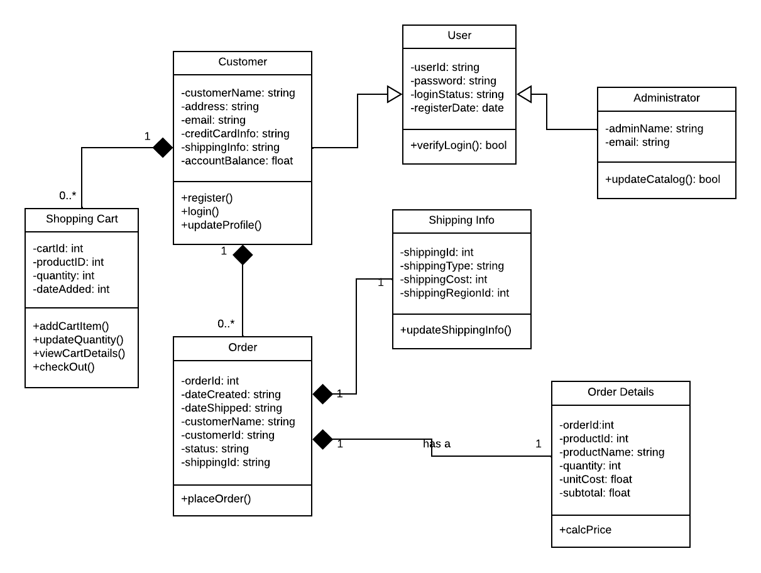

Slide 10
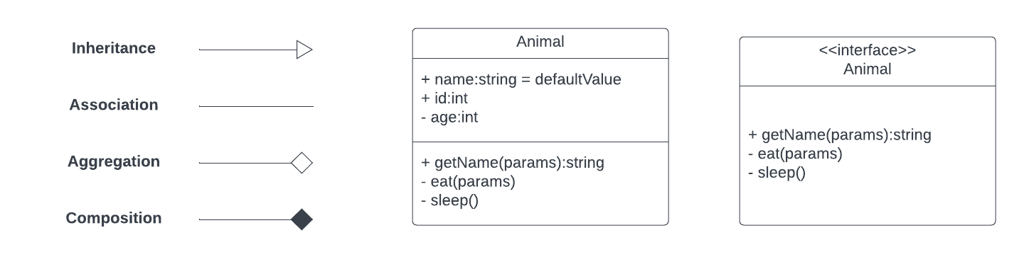

Slide 11
Outline
Unified Modeling Language
UML Class Diagram
Formal Specification Languages

Slide 12
Formal Specification Languages
A formal specification language is a notation that is used to describe the design of a system without having to implement it.
It involves formal verification where a piece of code is mathematically proven that it does what we expected to in all circumstances.
An important use of specification languages is enabling the creation of proofs of program correctness.
Examples of formal specification languages are Z notation and CASL.

Slide 13
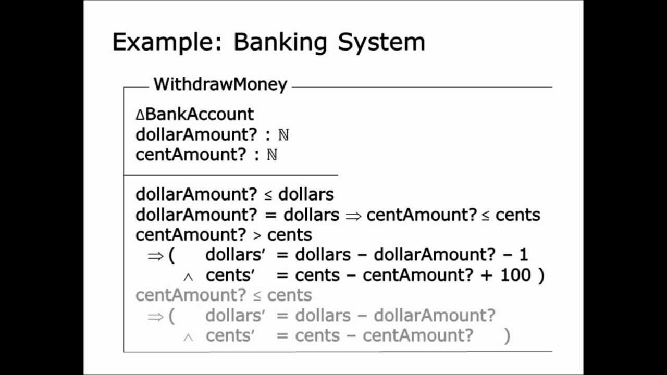
Z notation example

